Slide 1

General Biology
Dr. sraa nsayef

Slide 2
The Cell
Lab ((3))

Slide 3
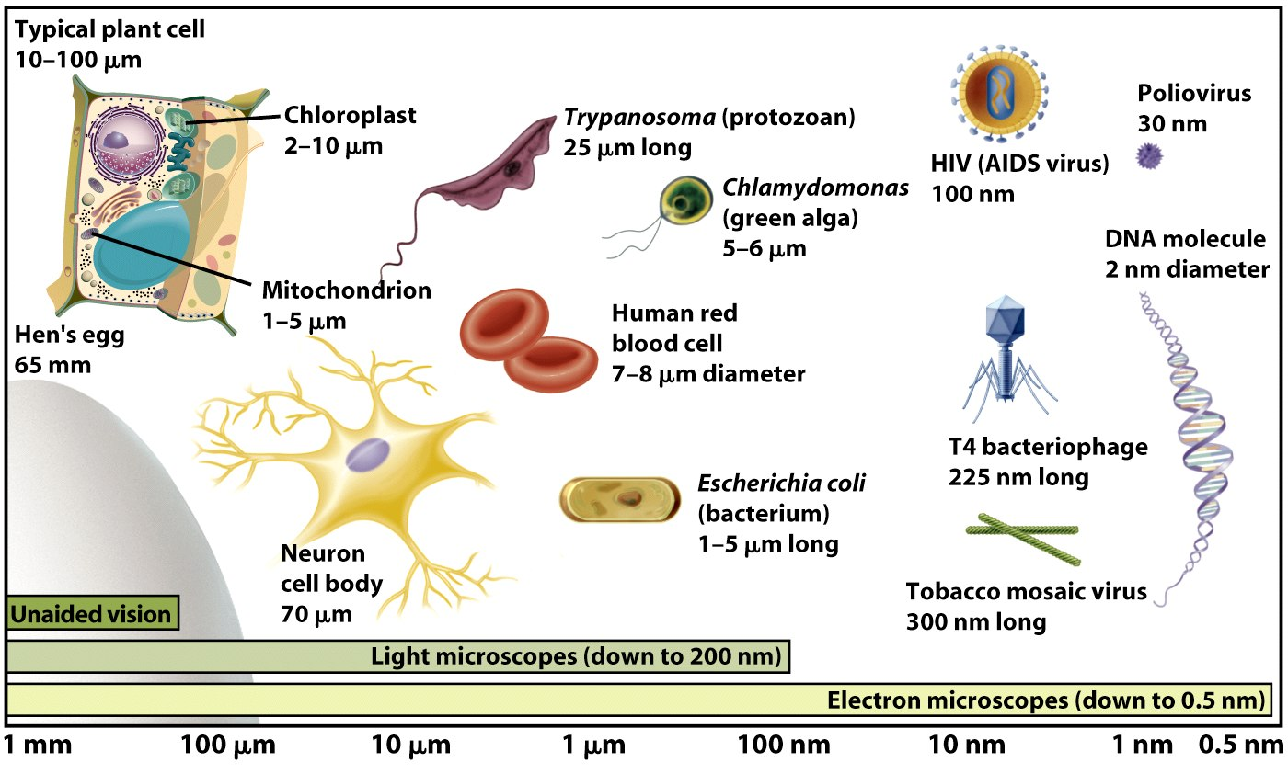
Cells are the basic units of life. Cell size is limited by the surface-area-to-volume ratio.

Slide 4
Characteristics of All Cells
A surrounding membrane
Protoplasm – cell contents in thick fluid
Organelles – structures for cell function
Control center with DNA

Slide 5
Type of Cells
Prokaryotic cells include bacteria and lack a nucleus or membrane-bound structures called organelles
Eukaryotic cells include most other cells & have a nucleus and membrane-bound organelles (plants, fungi, & animals).

Slide 6
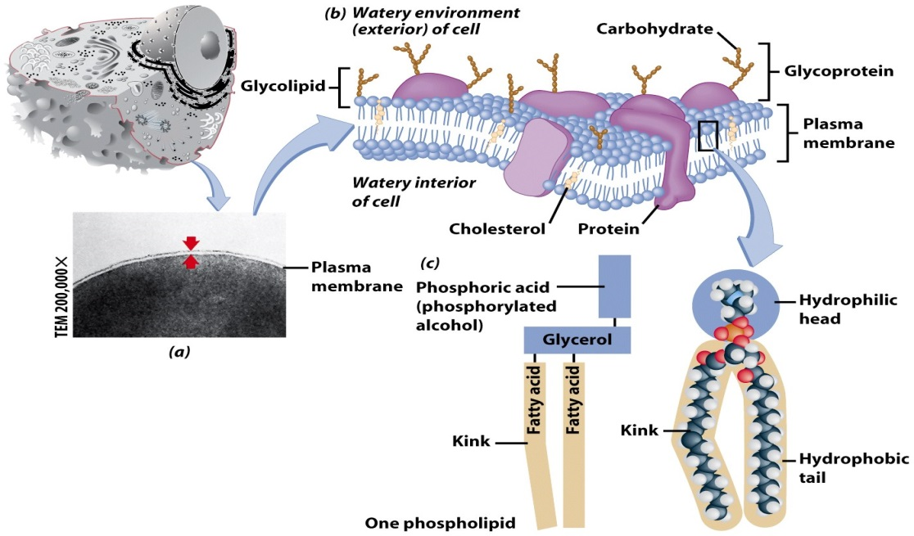
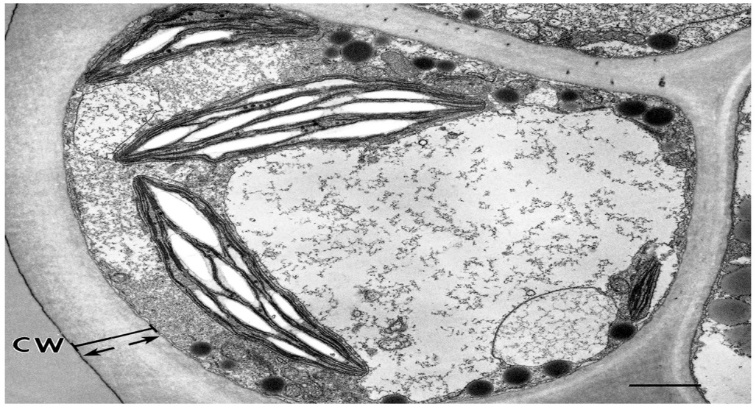
Plasma Membrane
Cell Walls

Slide 7
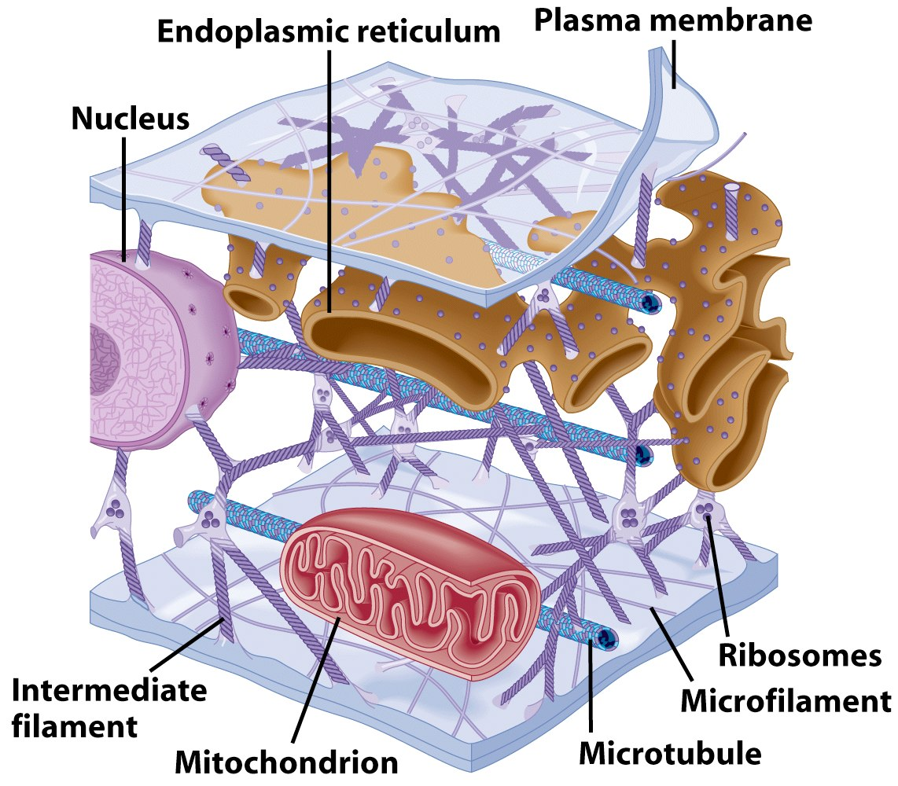
Cytoplasm

Slide 8
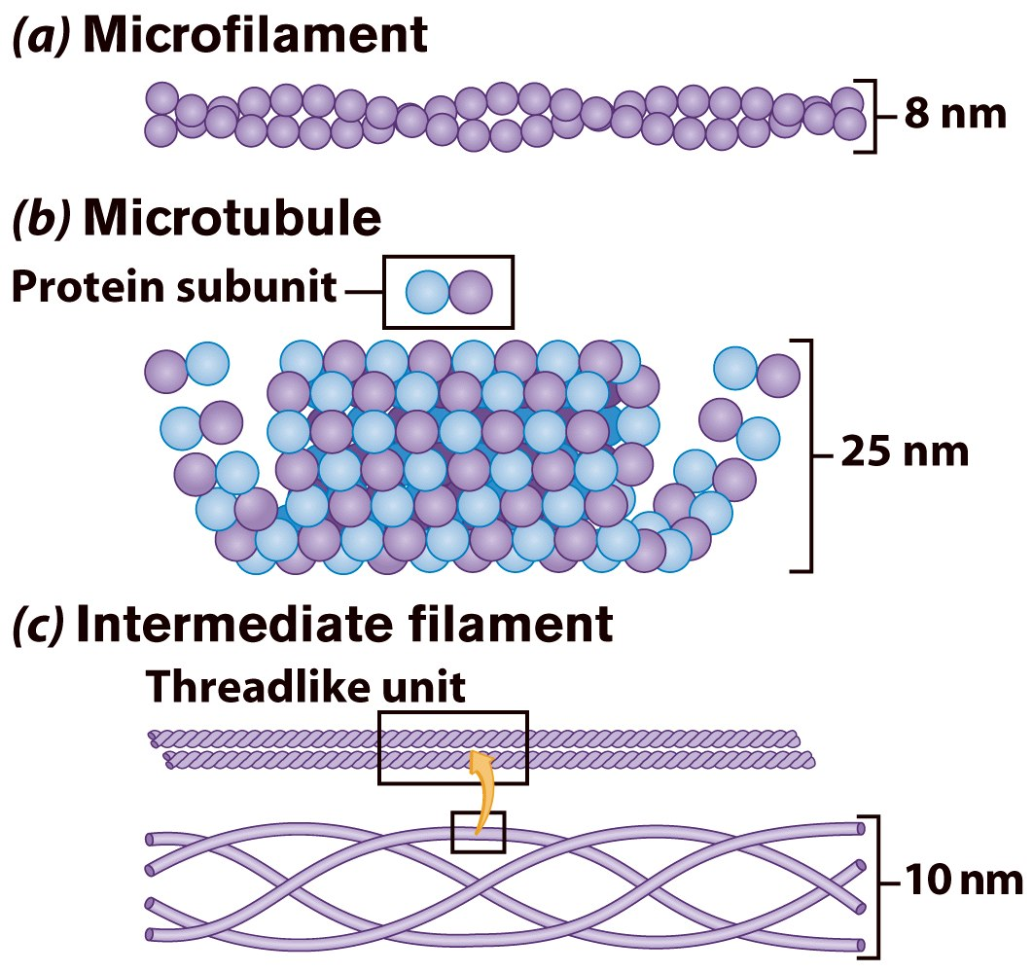
Cytoskeleton
Made of 3 fiber types
  1- Microfilaments
  2- Microtubules
  3- Intermediate filaments

Slide 9
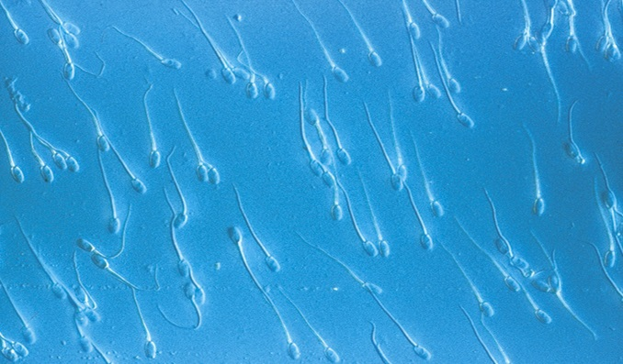
Cilia & Flagella

Slide 10
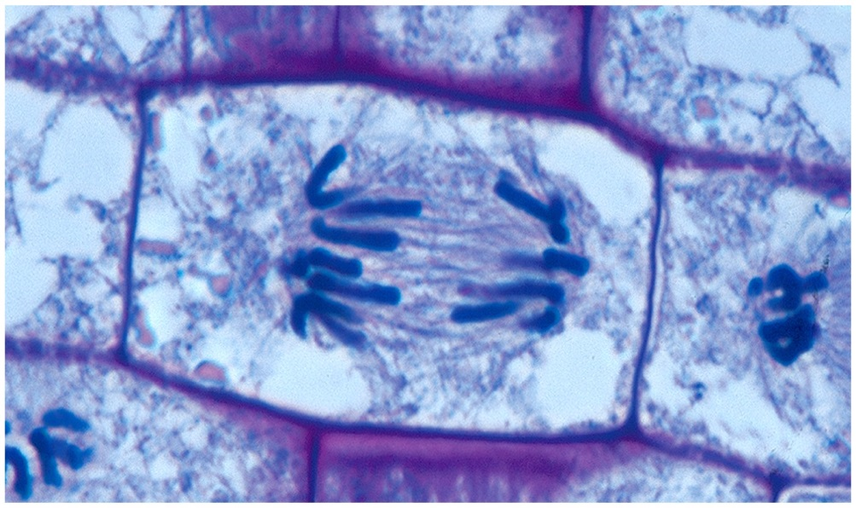
Centrioles

Slide 11
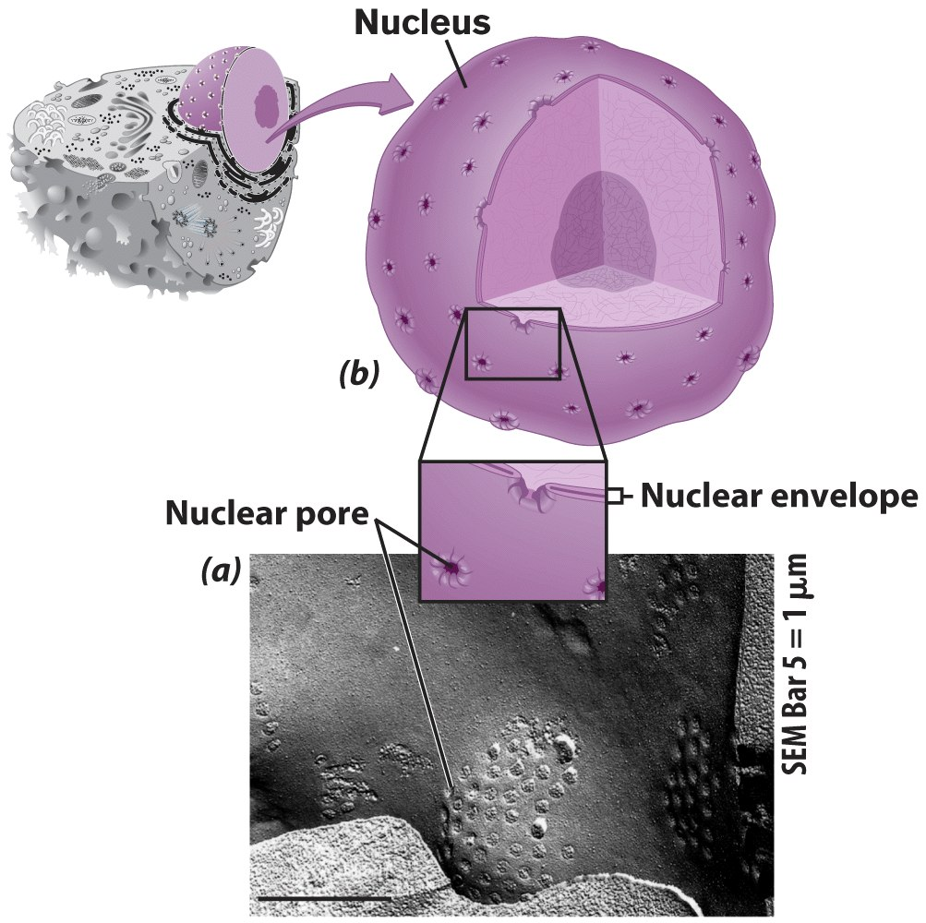
Nucleus

